Slide 1
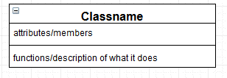
Notation: classes
This button is just a remnant from the software I used (draw.io)
Class name
This should match what you will eventually name the class
Attribute
Notation:
Name : Datatype
The data the class is working on. This includes state information
Mark arrays with []
Name : Datatype[]
Diagrams done with www.draw.io
For those who prefer text: https://plantuml.com/class-diagram

Slide 2
Notation: Functions
The major functions for the class
Alternatively, if you are early in the process, just a description of the class’s jobs/tasks
To state the return type:
Foo(name, name…) : datatype
Diagrams done with www.draw.io

Slide 3
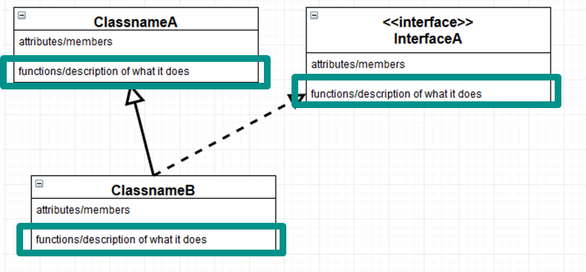
Notation: Functions
The first run of the diagram will normally be a description only
However…
If you KNOW you need it, add the function
If you KNOW you need it when working with other’s code (or people need yours), add the function
If you KNOW this will be needed for consistency, add the function

Slide 4
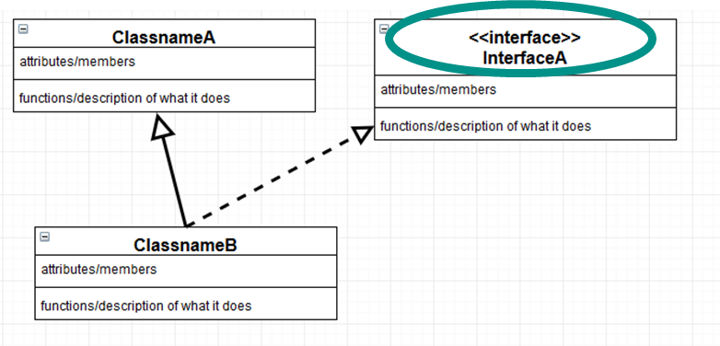
Notation: inheritance connections
Inheritance is shown with an arrow
Interfaces are tagged with <<interface>> or simply have the name in <<…>> (e.g. <<Animal>>). Ideally use a dashed arrow to show implementation (a solid arrow is OK)

Slide 5
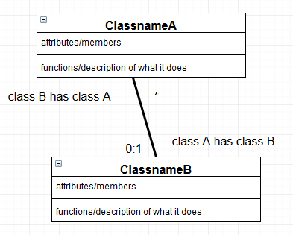
Notation: “has a” connections
A connection is shown with a line between two classes.
A connection has an optional “role” that describes the connection
The role of a class is on the far end of the line
Aside: True UML uses a large variety of different end caps

Slide 6
Notation: “has a” connections
A connection has a multiplicity (how many of a instances of a class that are owned).
1- just 1
0:1- 0 or 1
X:Y – X to Y instances
* - many
It is OK to have more than 1 connection between the same to classes
You MUST have a multiplicity or a very clear role. A role AND a multiplicity is better.

Slide 7
Notation: other info
Add additional notes if the diagram is not sufficient
E.g. private\public\protected is NOT mentioned
In UML these would be -, +, and # respectively
Abstract is also not mentioned and requires a note.
In UML it is italicized…but we can’t write italics by hand!
And more!
Make Abstract

Slide 8
Functions from scenarios
Allow for this task:
A Playter can choose a piece color
We need to add the functions we think we need to do this…

Slide 9
Functions
Where do we need to start this process?
CheckerProgram: we need to start the change. This call is internal, but they do not have to be..
Add getPlayer() : Player

Slide 10
Functions
What is next?
The player needs to set the color of all of its pieces.
Add color() : void
Next would be setColor(color : Color) in Piece, but we do not add those to the diagram.

Slide 11
Functions
To “check” if a tasks can be accomplished, either
Trace through the class diagram
Make a sequence diagram

Slide 12
Functions
Player
name : string
color() : void
Has 2
CheckersProgram
getPlayer() : Player
Piece
color : boolean
Has 1
Has 0..1
Has 0..12
Board
King
Square
color : Color
Has 64

Slide 13
Sequence diagram
CheckersProgram Player: Red Piece: 1 Piece: 2 … Piece: 6
getPlayer( )
red
color()
setColor(blue)
setColor(blue)
setColor(blue)
This is minimal. Sending in the color also makes sense.

